Slide 1
A Collaborative Community to Advance the Development and Adoption of Smart and Autonomous Medical Systems (SaAMS)
January 27, 2024
Julian M. Goldman, MD
Anesthesiologist, Massachusetts General Hospital, Dept. of Anesthesia, Critical Care, & Pain Medicine
Medical Director, Biomedical Engineering, Mass General Brigham
Director, MGH Medical Device Interoperability & Cybersecurity Program, and the
Center for Smart and Autonomous Medical Systems (SaAMS)
Boston, MA, USA
jmgoldman@mgh.harvard.edu

Slide 2
What are Smart and Autonomous Medical Systems (SaAMS)?
SaAMS describe medical systems in which apps connect to medical devices to deliver transformative patient-care solutions safely and efficiently.
SaAMS may use sophisticated algorithms that interact with interoperable medical devices to perform tasks that improve patient safety or efficiency, make decisions, automate processes, enhance vigilance, personalize patient and user experiences, advance healthcare equity, and solve historically intractable problems.
SaAMS algorithms may be based on artificial intelligence (AI) to adapt to new information, make predictions, and operate autonomously.
Solutions to long-standing gaps in clinical technology effectiveness and patient safety will benefit from SaAMS-based technologies.

Slide 3
Examples of SaAMS:
Automated closed loop control of intravenous anesthesia (ACLIVA)
Closed-loop vasopressor (blood pressure) therapy
Closed-loop IV fluid administration
Remote (external) control of IV Infusion Pumps
Remote (external) control of Lung Ventilators
AI-based predictive clinical analytics
Smart alarms that improve sensitivity to clinically significant events and enhance specificity to reduce non-actionable alarms and reduce alarm fatigue
Integrating actuators, sensors, and smart clinical algorithms are the foundational components of these SaAMS.

Slide 4
The Benefits of a SaAMS Collaborative Community
A Collaborative Community can address challenging medical technology needs that no single manufacturer or other entity may be able to accomplish alone.
This includes identifying and advancing key enabling device features and clinical system capabilities that address complex engineering and clinical challenges
MGH has formed a Collaborative Community, as defined by the FDA, “to achieve common outcomes, solve shared challenges, and leverage collective opportunities” to advance the maturity, adoption, and clinical use of SaAMS to improve patient care.

Slide 5
Who is participating in the SaAMS Collaborative Community?
Participants in the SaAMS Collaborative Community will include a wide range of experts:
manufacturers
clinicians,
engineers
researchers
Regulators (US FDA)
Other government agencies
Societies (Medical, Engineering, Regulatory, etc.)

Slide 6
What can the SaAMS Collaborative Community deliver? Deliverables are focused on evidence to support the safety and efficacy of SaAMS.
Concept(s) of operation of the SaAMS systems including descriptions of clinical scenarios to assure conceptual interoperability
Description of system components, architecture, and the necessary device data and control commands to assure safe operation and support re-use of sensors and actuators (aligned with Medical Device Interface Data Sheets - MDIDS)
Use-case specific best practices
Safety Assurance Case(s) and a shared risk model
Considerations for implementation in Integrated Clinical Environments (ICE) on platforms with interoperable, externally-controllable actuators, sensors, and smart clinical algorithms
Data logging / black box recorder requirements for quality assurance
Test methods – failure modes, fallback state(s), interoperability, communication degradation
White papers, presentations, publications, content for inclusion in industry consensus standards

Slide 7
It is anticipated that the SaAMS CC will begin with the following projects
1. ACLIVA – identification and documentation of current barriers to advancing Automated Closed Loop IV Anesthesia, including,
2. Externally controllable IV infusion pumps – current barriers to marketing
3. Risk management and safety considerations for SaAMS - safety requirements and test methods.
4. Test bench/test bed for verification and regulatory support
5. Cybersecurity applicable to SaAMS – strategic assessment and pathway to advancement

Slide 8
ACLIVA are complex systems, as such, this Project may spawn separate work streams such as:
Medical Device Informatics related to medical device command and control:
Selection and analysis of data communication patterns and quality of service requirements for reliable medical device control
Nomenclature to support interoperability of IV pump control commands
Requirements to achieve functional safety of networked systems that require high levels of safety and reliability for SaAMS
Hardware-in-the-loop testbeds for ACLIVA device interface, component, and system testing
Guidelines and test methods for demonstrating equivalency for interoperable sensors, actuators, and applications

Slide 9
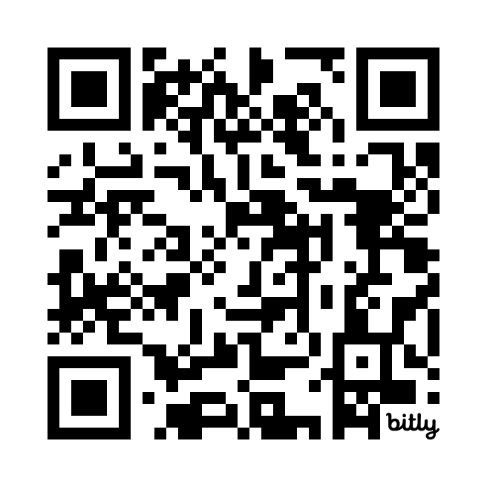
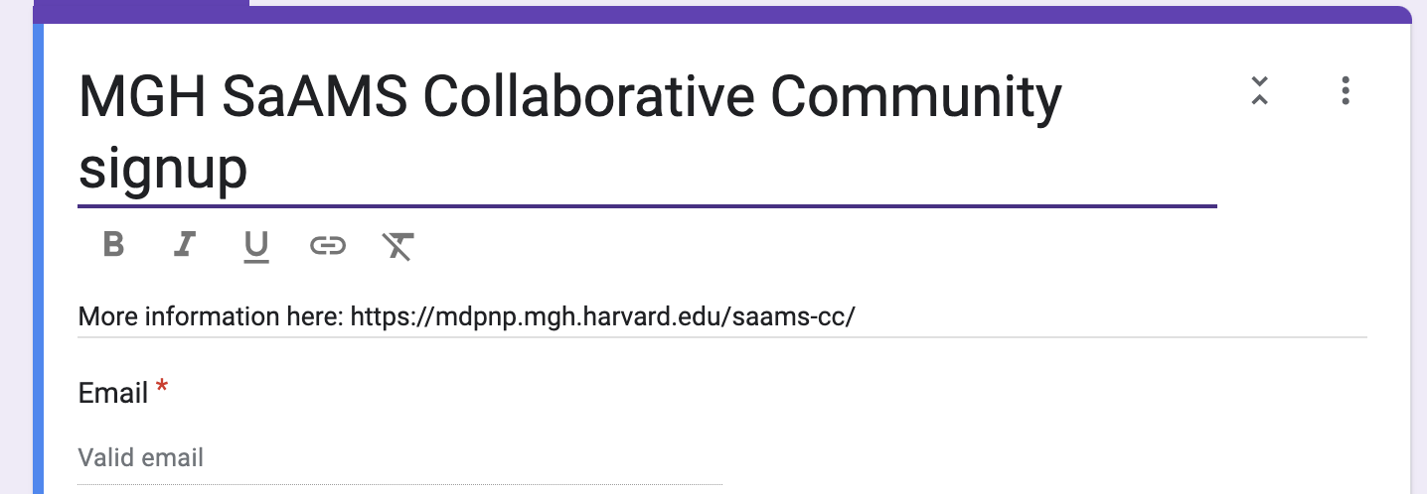
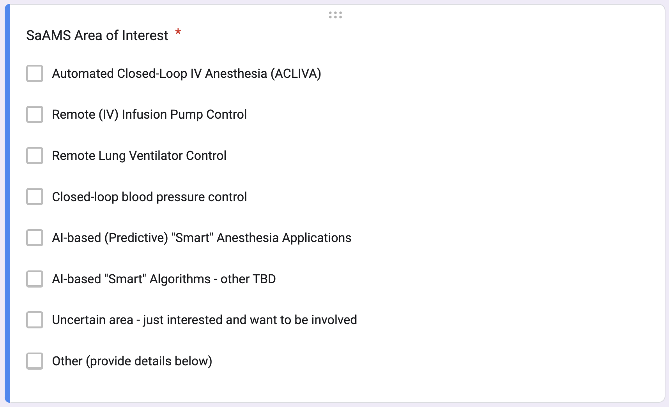
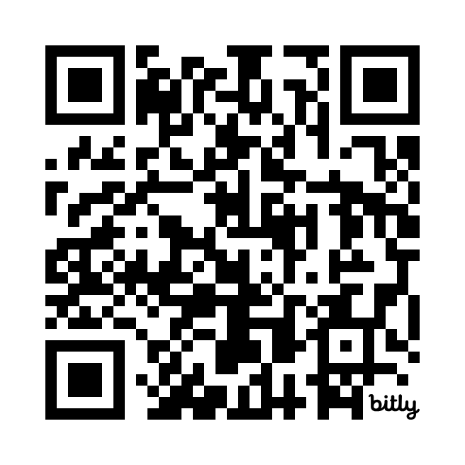
MGH MD PnP Website SaAMS CC Information Page:
Sign-up Form: https://bit.ly/SaAMS_Signup10
https://bit.ly/SaAMS

Slide 10
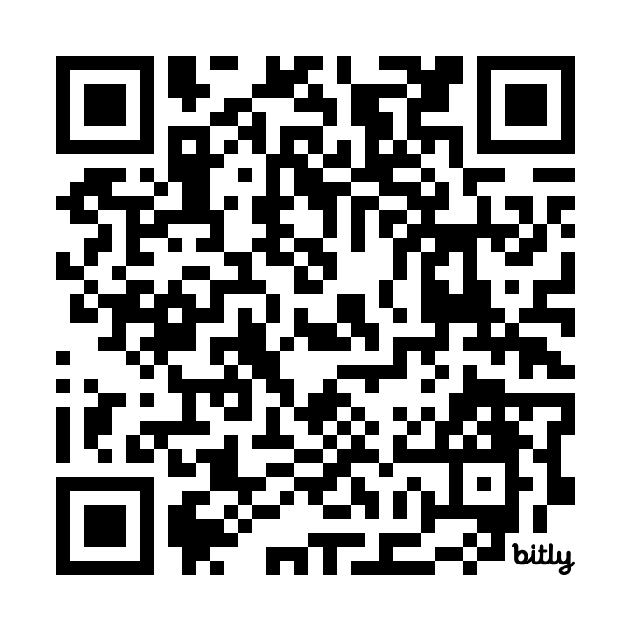
draft Charter for SaAMS Collaborative Community
PDF on Google Drive:
http://bit.ly/SaAMS_Charter_draft1

Slide 11
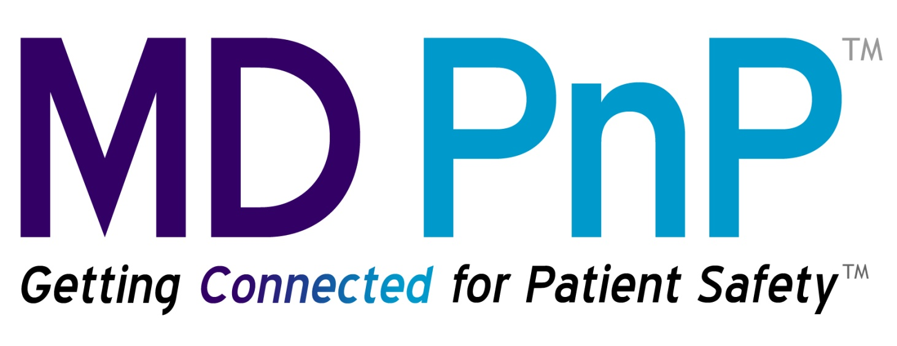
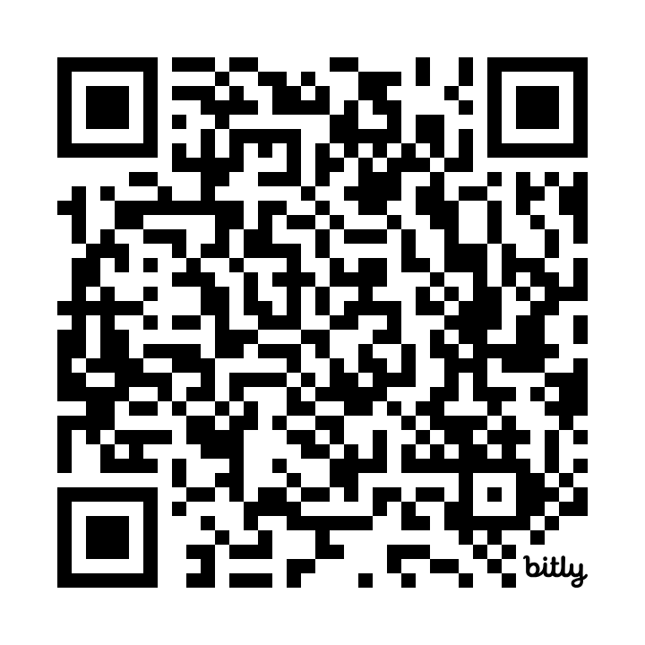
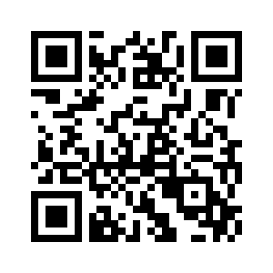
The Need for a Collaborative Community to Advance the Development and Adoption of
Smart and Autonomous Medical Systems (SaAMS)
Julian M. Goldman, M.D^{1,2}., Yi Zhang, Ph.D.¹
¹Center for Smart and Autonomous Medical Systems / Medical Device Interoperability and Cybersecurity Program (MD PnP)
Department of Anesthesia, Critical Care and Pain Medicine. Massachusetts General Hospital; ²Harvard Medical School, Boston, Massachusetts
Excerpt from STA 2020 Poster
Excerpt rom STA 2020 Poster
Examples of SaAMS applications
STA 2020 Poster:
Verification of Interoperable Medical Devices for
Closed-Loop Control of Anesthesia using Hardware-in-the-Loop Testing
J Goldman, Y Zhang, D Arney, S Weininger(FDA)
“The performance of medical devices (core medical functions and interface capabilities) must be characterized in detail to safely comprise the CLC system.
This poster documents the application of our research hardware-in-the-loop testbed for interoperable CLC devices.”
The anesthesia technology community should collaborate to establish consensus safety, regulatory, and performance requirements that can be used as a baseline to characterize the capabilities of interoperable medical devices to enable and promote CLC anesthesia innovation.
To address that need, we are establishing a Smart and Autonomous Medical Systems (SaAMS) initiative to facilitate engagement by interested stakeholders (medical device manufacturers, health delivery organizations, funding entities, and regulators). We welcome your participation in the SaAMS initiative.
The SaAMS initiative progressed under TATRC NETCCN/TiDE and DoD FCT grant portfolios.
Automated Closed Loop control of Intravenous Anesthesia (ACLIVA)
Closed-loop vasopressor therapy
Closed-Loop Fluid Administration
Remote IV Infusion Pump Control and Remote Lung Ventilator Control
Smart alarms that improve and specificity
AI-based predictive clinical analytics
http://bit.ly/STA2024_Poster_SaAMS
What are Smart and Autonomous Medical Systems (SaAMS)?
SaAMS describe a wide range of medical systems designed from the ground up to enable smart apps to connect to medical devices to more safely and efficiently deliver transformative patient care solutions.
SaAMS may utilize sophisticated algorithms interacting with interoperable medical devices to perform tasks that improve patient safety or efficiency, make decisions, automate processes, enhance vigilance, personalize patient and user experiences, advance healthcare equity, and solve historically intractable problems. They may utilize artificial intelligence (AI) to adapt to new information, make predictions, and operate autonomously.
2024 SaAMS Collaborative Community
References
2023: SaAMS “Initiative” → Collaborative Community
A Collaborative Community can address challenging medical technology needs that no single manufacturer or other entity may be able to accomplish alone. This includes identifying and advancing key enabling device features and clinical system capabilities that address complex engineering and clinical challenges.
We are forming a Collaborative Community, as described by the FDA,
“to achieve common outcomes, solve shared challenges, and leverage collective opportunities” to advance the maturity, adoption, and clinical use of SaAMS to improve patient care. ¹
Participants in the SaAMS Collaborative Community will comprise a wide range of experts including manufacturers, clinicians, engineers, researchers, government representatives, and the US FDA, to collaborate on the development of evidence to support safety. This safety framework is intended to provide precompetitive evidence for use in the regulatory process to de-risk commercial development and increase the safety, effectiveness, and clinical usability of these systems.
Collaborative Communities: Addressing Health Care Challenges Together, https://www.fda.gov/about-fda/cdrh-strategic-priorities-and-updates/collaborative-communities-addressing-health-care-challenges-together
MGH SaAMS Collaborative Community https://mdpnp.mgh.harvard.edu/saams-cc/
MD PnP Center for SaAMS https://mdpnp.mgh.harvard.edu/saams-center/
Poster and Panel Presented at the
Society for Technology in Anesthesia Annual Meeting
Houston, TX, January 2024
Acknowledgements
This research was supported in part under the Medical Technology Enterprise Consortium(MTEC) Research Project Number W81XWH-22-9-0004, funded by the Foreign Comparative Testing Program of the US Department of Defense (DoD). The views, opinions and/or findings contained in this poster are those of the authors and should not be construed as an official DoD position, policy or decision unless so designated by other documentation.

Slide 12
Society for Technology in Anesthesia Board of Directors: Unanimous Approval for SaAMS Collaborative Community January 14, 2024, Houston, Tx
Regarding the newly formed MGH Collaborative Community on Smart and Autonomous Medical Systems (SaAMS CC),
Whereas a CC, as described by the FDA, can generally “achieve common outcomes, solve shared challenges, and leverage collective opportunities”, it can be applied to SaAMS to advance the maturity, adoption, and clinical use of SaAMS to improve patient care, and…
Whereas the public launch of the SaAMS CC at a panel at STA ’24 was enthusiastically received by STA clinical, research, and industry members, and
The Society will participate as a member of the SaAMS Collaborative Community and consider including, and contributing relevant information about, the rapidly evolving landscape related to innovation, standards, and risk management of Smart and Autonomous Medical Systems in Annual Meeting sessions

